Slide 1
Predicting tree types found in the Roosevelt National Forest in Colorado
Team members:
Sai Anish Chowdary Bezawada (801312402)
Pranav Sundaresan Babu (801254287)
Sushma Narne (801269072)
Sai Rachana Reddy Vanipenta (801266847)
Abhishekji Dumala (801307903

Slide 2
DATASET DESCRIPTION
The Roosevelt National Forest in northern Colorado's Roosevelt National Forest is included in the Forest Cover Type dataset from the UC Irvine Machine Learning Repository.
The target variable is a categorical variable that represents the cover_type of the forest, which has seven potential classes, in the dataset, which also contains continuous and categorical variables.
Key columns in the dataset used for visualizations: Wilderness_Area, Soil_Type, Horizontal_Distance_To_Hydrology, Hillshade_Noon ETC.
The "Wilderness_Area" and "Soil_Type" attributes are binary columns indicating whether ornot the forest observation falls into a particular wilderness area or soil type, respectively.

Slide 3
PROBLEM STATEMENT
Understanding of the various forest types and their features is a business opportunity or challenge that must be kept in mind in order to make decisions about land management and conservation initiations.
Business problem is to create a Machine Learning Model which predicts the forest’s cover type with the various features/attributes and to determine the most important features that would help us achieve the goal.
Creating a model that would give an overview of the forest’s cover type depending on various characteristics such as, elevation type, slope type and the most important is the type of soil.

Slide 4
RESEARCH OBJECTIVES
Evaluating the performance of different machine learning algorithms for the prediction the forest cover type, and identifying the algorithm which performs the best for this model.
Identify any patterns or trends in the forest cover types over time, and understand how changes in land management and environmental factors may be contributing to these trends.
Investigate the potential impacts of climate change on the forest cover types and associated vegetation, and understand how the forest cover types may shift over time in response to changing environmental conditions.

Slide 5
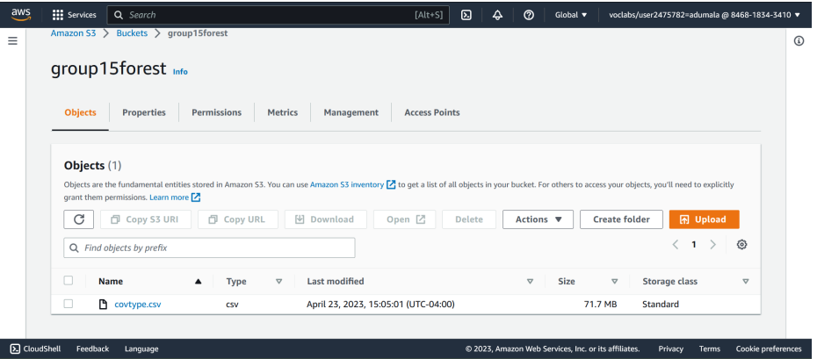
DATA UNDERSTANDING
a)Exploratory Data Analysis
We uploaded the data to an S3 bucket named group15forest and used the AWS S3 copy command to load it into a Jupyter notebook instance. Afterwards, we combined the data into a single dataframe.

Slide 6
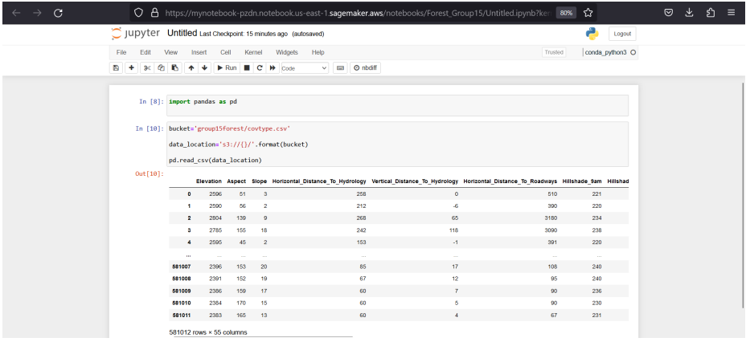
DATA UNDERSTANDING
To connect the dataset with Jupyter Notebook, we used the following code to read the dataset:

Slide 7
DATA PREPARATION
Exploratory Data Analysis on CSV File using Pandas and NumPy Libraries
The code reads a CSV file from an S3 bucket.
It uses Pandas and NumPy libraries to perform exploratory data analysis on the dataset.
The code prints the number of rows and columns in the data.
It also displays the data types, summary statistics, missing values, and unique values for categorical columns in the dataset.
The exploratory data analysis helps to identify patterns, trends, and outliers in the data, which is useful in developing insights and making informed decisions.

Slide 8
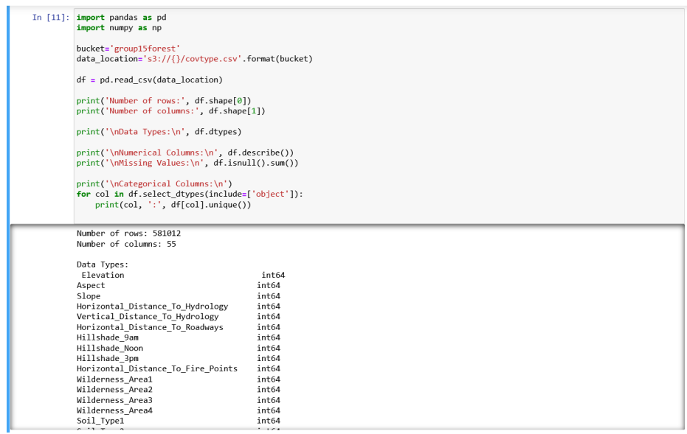
DATA PREPARATION

Slide 9
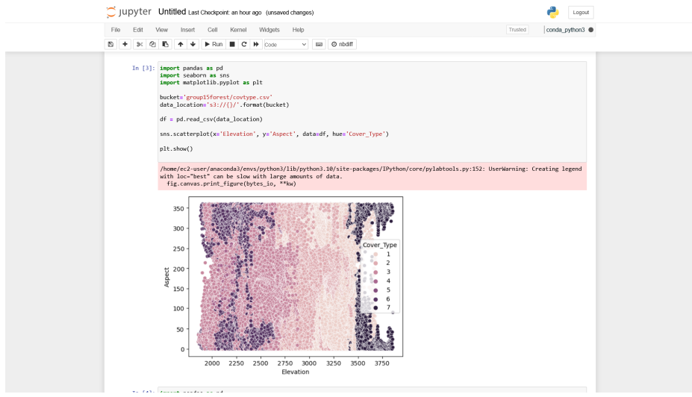
DATA VISUALIZATIONS
Scatter plot analysis of Forest Cover Types based on Elevation and Aspect:-
The scatter plot shows how the elevation and aspect of distinct forests correlate with one another. Depending on the type of cover, the plot is color-coded. The plot also shows that different forms of forest cover are concentrated in particular areas, suggesting that elevation and aspect may be important factors in determining the type of forest cover.

Slide 10
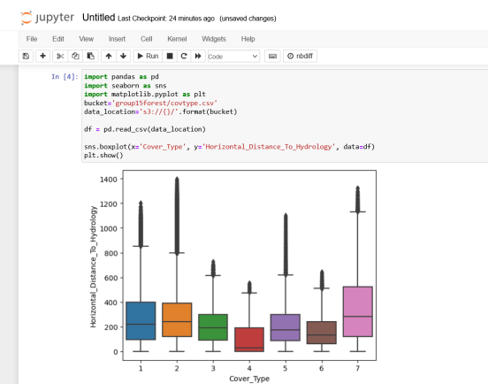
Box Plot Analysis of Horizontal Distance to Nearest Water Source for Forest Cover Types
The box plot depicts the distribution of the horizontal distance (hydrology) to the closest water source for each of the seven types of forest cover. Each box's horizontal center line indicates the median value, while the box's upper and lower margins indicate the interquartile range. Individual outliers are additionally shown in the graphic by dots above or below the whiskers.

Slide 11
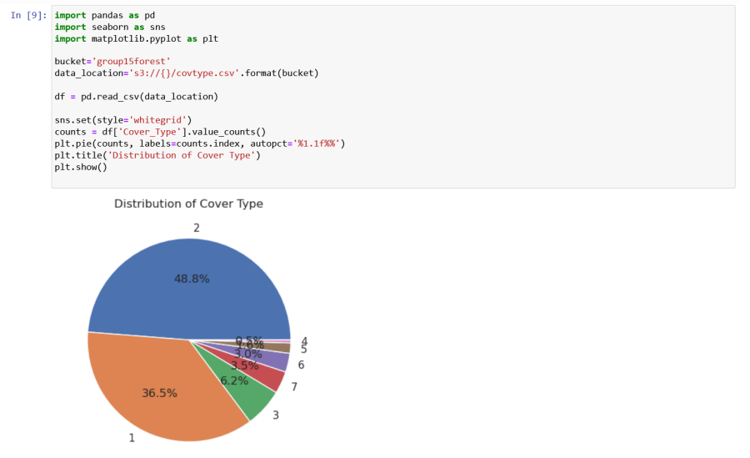
Pie Chart Analysis of Cover Type Distribution in the Dataset
The distribution of the different cover types in the dataset is shown in the pie chart. The size of each slice in the graph, which represents a different type of cover, corresponds to the number of observations. The figure also has labels inside each slice that show the proportion of observations for each type of cover.

Slide 12
Analytics and Machine Learning
The Forest Cover Type dataset contains 55 features that provide comprehensive information about different aspects of forest cover.
Before building an analytical model, the data was cleaned by removing null values and special characters.
The Z-score approach, which rates each data point according to its originality and size, was used to eliminate outliers.
Dataset is divided into two divisions training set with 80% of data and testing set with 20% of data.
Two models were created to predict the cover type: a decision tree model and a linear regression model. The dataset was divided into training and testing sets.
The decision tree model's accuracy score is also determined, and it comes out to 0.9394, meaning that for 93% of the testing data, the model successfully identified the cover type.
These models are illustrations of machine learning algorithms, which generate predictions based on the patterns and correlations they discover in data using statistical approaches.

Slide 13
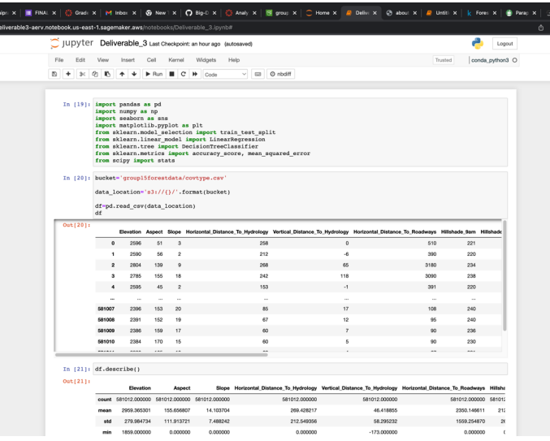
The code is to read the dataset and connect with jupyter notebook.

Slide 14
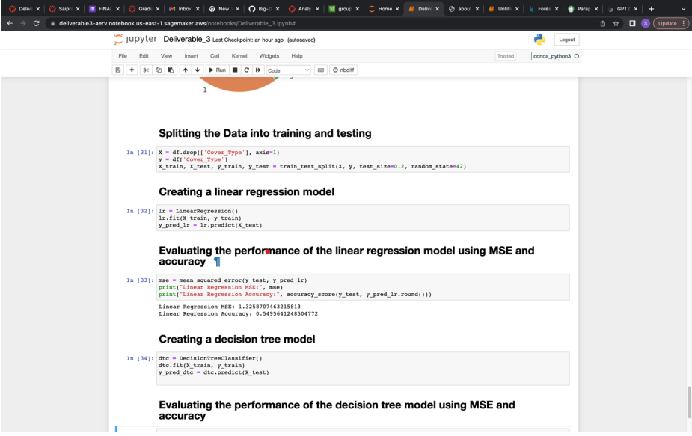
Linear Regression Model and Decision Tree Model

Slide 15
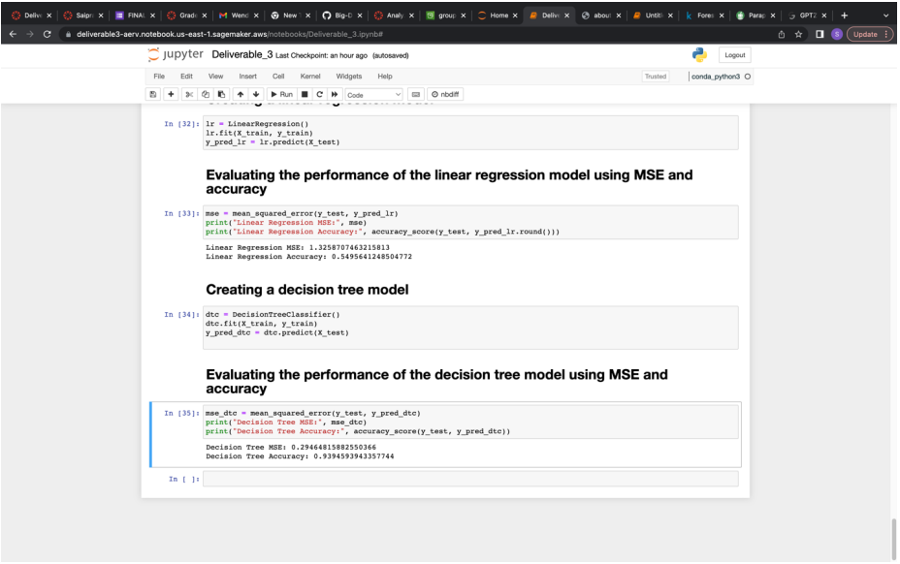
Calculation of Accuracy and MSE for Linear Regression and Decision Tree Model

Slide 16
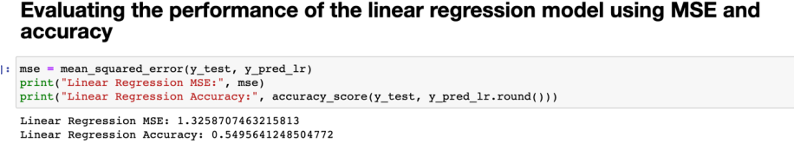
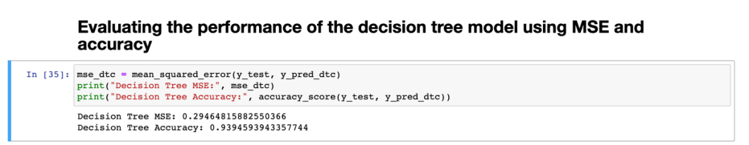
Evaluation and Optimization
Accuracy scores and mean squared error (MSE) are used to assess the performance of the models. MSE evaluates how well the model's predictions agree with the data, whereas accuracy counts the proportion of accurate predictions.
The linear regression model's MSE is 1.3258, meaning that the predictions are on average 1.325 units off from the actual values. For 20% of the testing data, the model's accuracy score of 0.5495 indicates that it is not accurately identifying the cover type.
We choose to train the model using Decision Tree Regression, which implements a tree structure, to maximize the outcome achieved using Linear Regression. For this method as well, we are once more calculating the mean squared error. Following decision tree regression, the mean squared error is MSE = 0.2946.

Slide 17
RESULTS
We built, trained, and tested our dataset using supervised machine learning methods such as linear regression and decision tree regression. We obtained accuracy of 54% using linear regression.
As a result, we chose to use the decision tree regressor approach to create our machine learning model using the same set of inputs, and this time, we achieved a superior accuracy of 93%. Our dataset contains outliers, or columns with a small number of values that are much higher or lower than most of the other values. This causes a 7% loss.
Therefore, if predictions of future Forest cover type was made, they can be considered 93% accurate.

Slide 18
FUTURE WORK AND COMMENTS
1.What was unique about the data? Did you have to deal with imbalance? What data cleaning did you do? Outlier treatment? Imputation?
The Forest Cover Type dataset is a unique resource for studying forest cover and determining which tree species are present in each area since it offers thorough information on many characteristics of forest cover. To address the imbalance in the dataset, we employed strategies including stratified sampling. The data was cleaned by removing null values and special characters, eliminating superfluous columns, and normalizing numerical characteristics using z-scores. We did not impute anything onto the dataset; instead, we removed outliers using the Z-score approach.
2. Did you create any new additional features / variables?
Based on domain expertise, we developed several additional properties, such as slope and aspect ratios, distance to water, and distance to roads.
3. What was the process you used for evaluation? What was the best result?
We used various performance metrics to evaluate our models, including accuracy, MSE. We also used k-fold cross-validation to estimate model performance and prevent overfitting. The best result was achieved using a decision tree classifier, which achieved an accuracy of 93% on the test set.

Slide 19
FUTURE WORK AND COMMENTS
4 What were the problems you faced? How did you solve them?
The dataset's imbalance was one issue we encountered, which made it difficult to forecast the minority classifications with accuracy. By balancing the classes utilizing oversampling strategies stratified sampling, we were able to overcome this issue. We also confronted the issue of overfitting, which we dealt with by employing regularization methods like L1 and L2 regularization.
5. What future work would you like to do?
To further improve model performance, we intend to investigate more sophisticated machine learning techniques including deep learning and ensemble approaches in future work. To enhance model interpretability, we also want to investigate additional feature engineering strategies.
6. Instructions for individuals that may want to use your work
In order to get similar findings, those who are interested in exploiting our work should bear the following in mind:- Install the essential Python libraries, mainly Numpy, Pandas, MatPlotlib, Sns, and sklearn, which are significantly utilized in the execution of this project.Make sure the majority of the outliers are eliminated from the dataset by doing rigorous data cleansing, transformation, and preparation. As a result, machine learning models and visualizations would be correct.

Slide 20
THANK YOU

